Slide 1
Bài 1. Review Networking Essentials

Slide 2
Contents
1. Networking fundamentals
OSI & TCP/IP models
IP addressing
Packet delivery process
2. Network Infrastructure technologies
Routing technologies
LAN switching technologies
3. Network Services
DHCP
DNS
Web
FTP
Email

Slide 3
Networking fundamentals

Slide 4
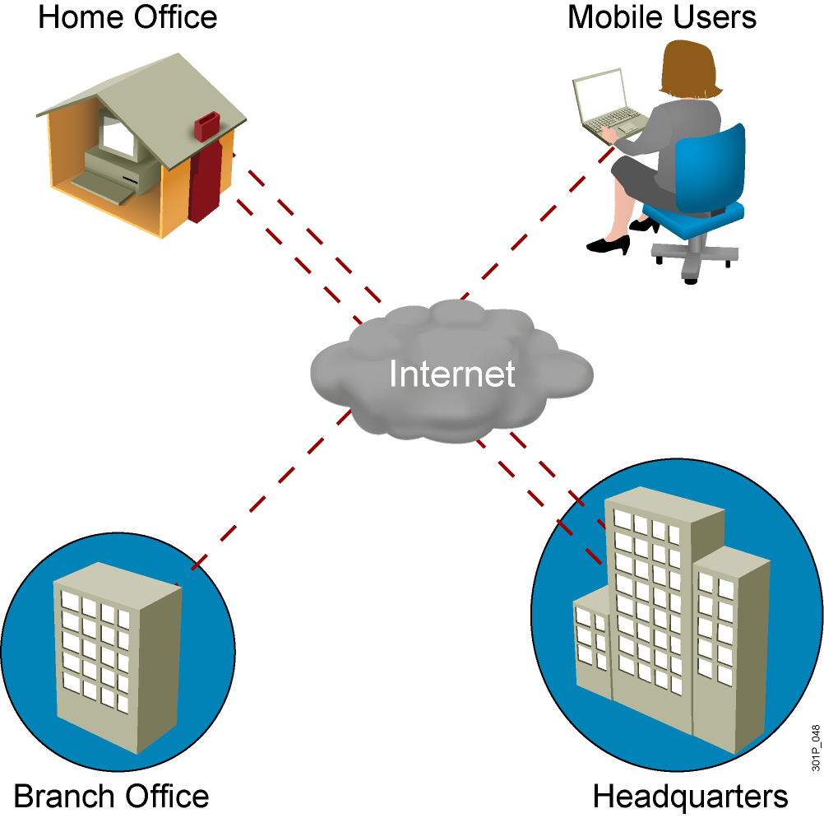
What is a network?

Slide 5
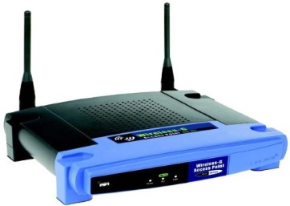



Network representations
End devices
Intermediary devices
Network Media
Computer
Laptop
IP phone
Router
Switch
AP
Wireless
LAN
WAN

Slide 6
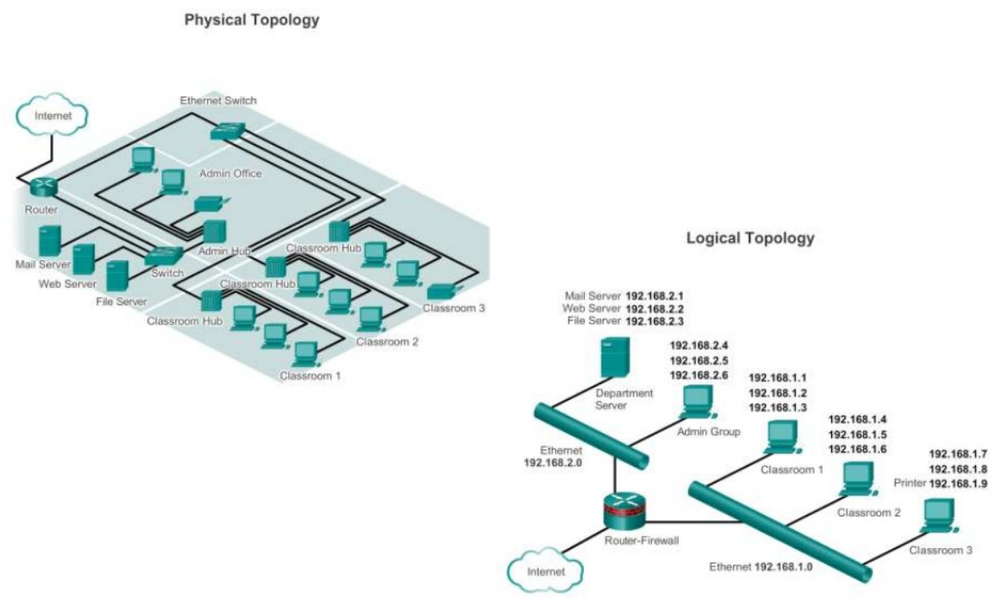
Network topology
May also called “topology diagrams”

Slide 7
Types of networks
The two common types of network infrastructures are:
Local Area Network (LAN)
Wide Area Network (WAN)
Internet
Other types of networks include:
Metropolitan Area Network (MAN)
Wireless LAN (WLAN)
Storage Area Network (SAN)

Slide 8
OSI & TCP/IP models
Two different types of host-to-host models:
Older model
Proprietary
Applications and combination of software controlled by one vendor.
Standards-based model
Multivendor software
Leyered approach
Examples: OSI, TCP/IP

Slide 9
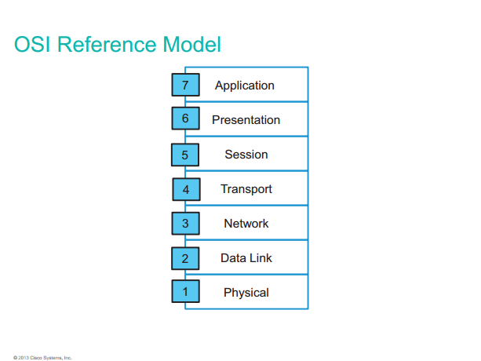

Slide 10
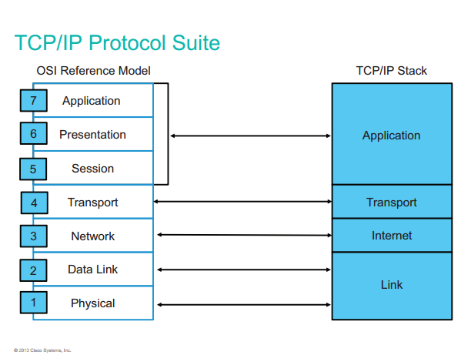

Slide 11
Data encapsualtion & De-encapsulation

Slide 12
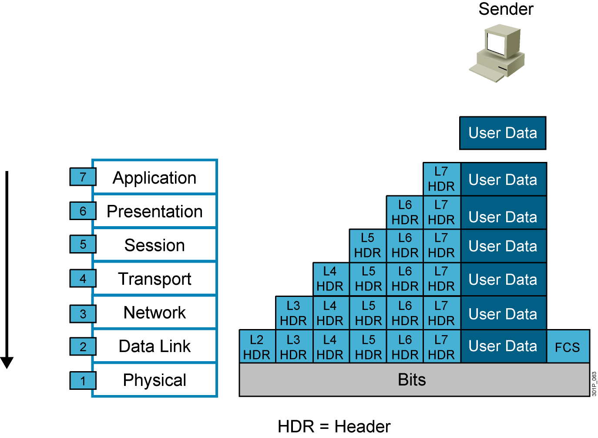
Data Encapsulation
Notes:
Lesson Aim
<Enter lesson aim here.>

Slide 13

Data De-Encapsulation
Notes:
Lesson Aim
<Enter lesson aim here.>

Slide 14
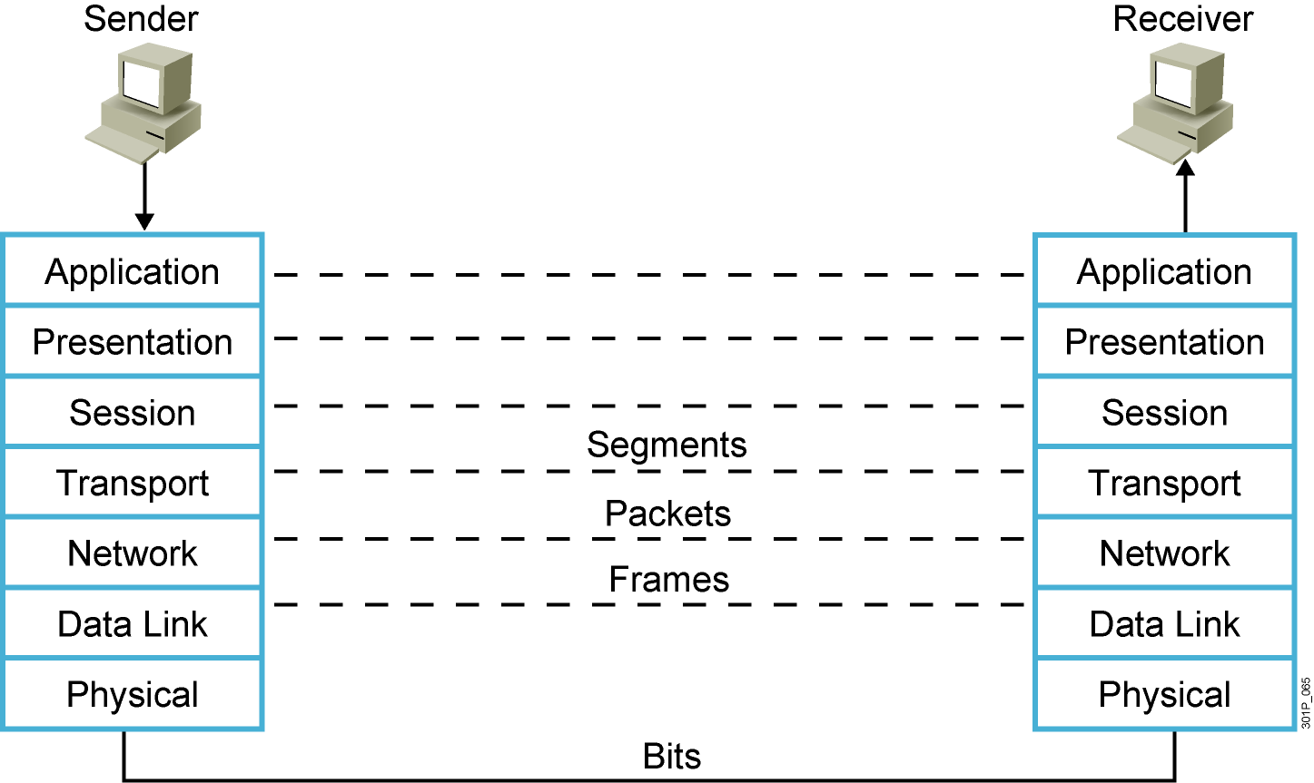
Peer-to-Peer Communication
Notes:
Lesson Aim
<Enter lesson aim here.>

Slide 15
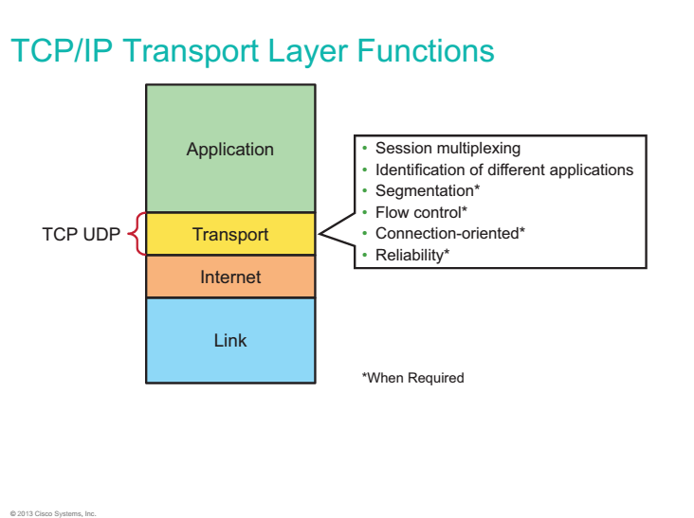

Slide 16
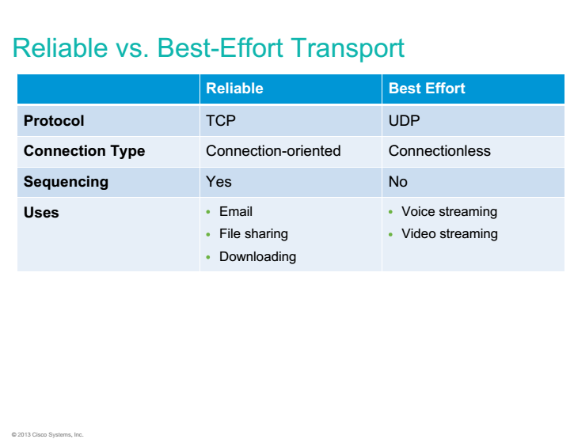

Slide 17
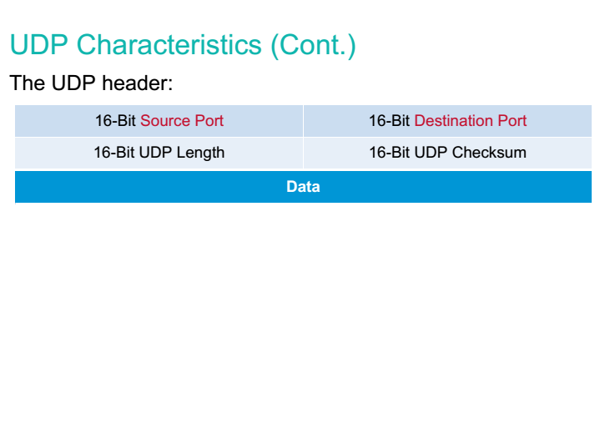

Slide 18
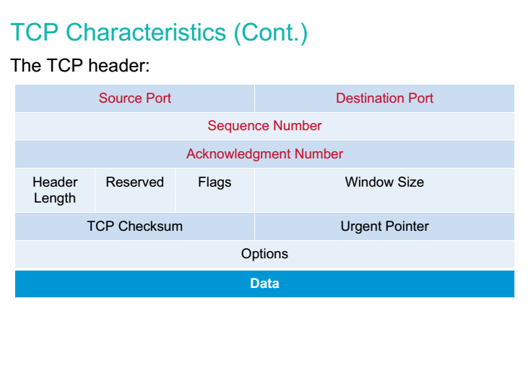

Slide 19
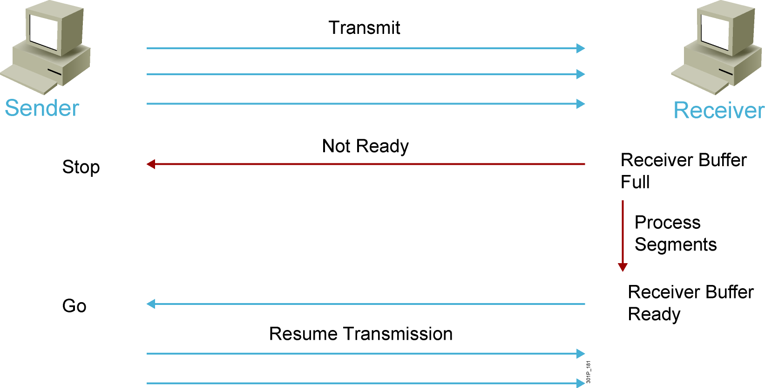
Flow Control (tt)
Notes:
Lesson Aim
<Enter lesson aim here.>

Slide 20
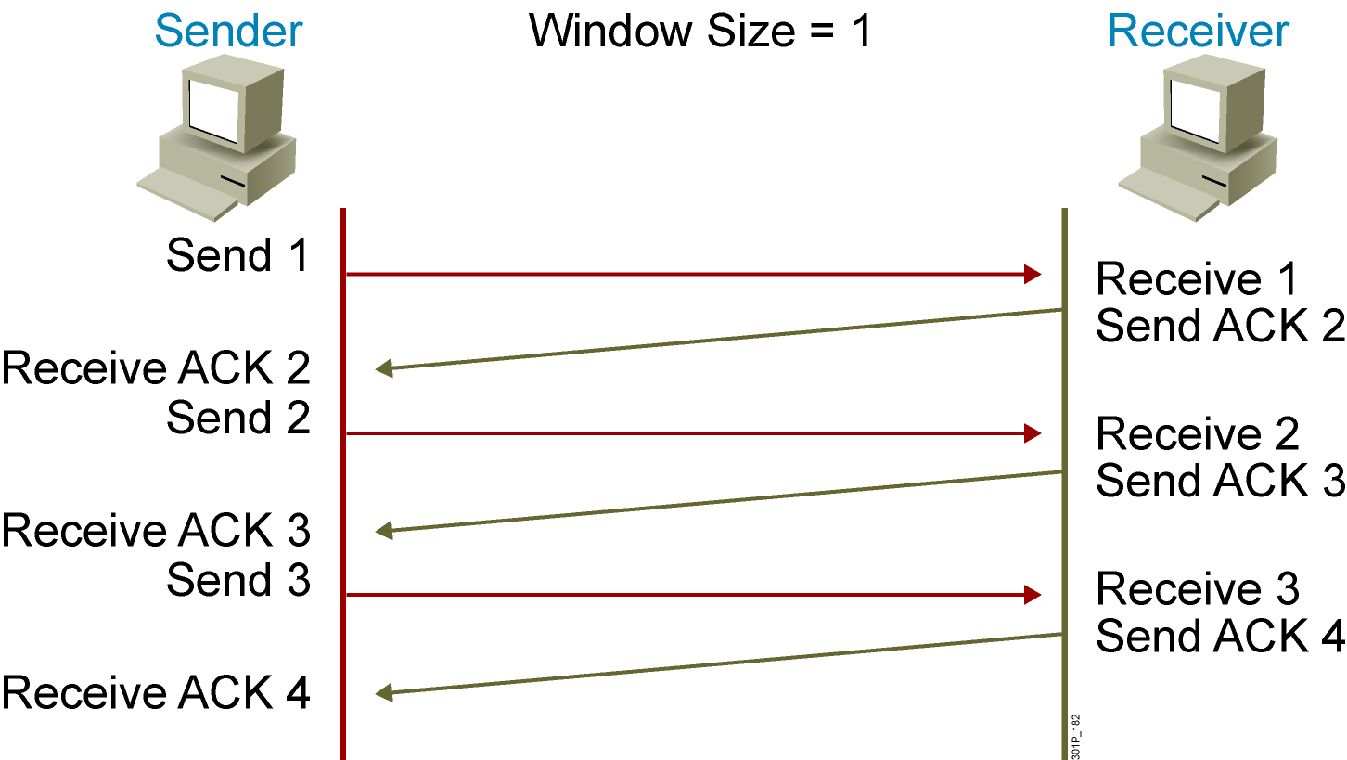
TCP Acknowledgment
Notes:
Lesson Aim
<Enter lesson aim here.>

Slide 21
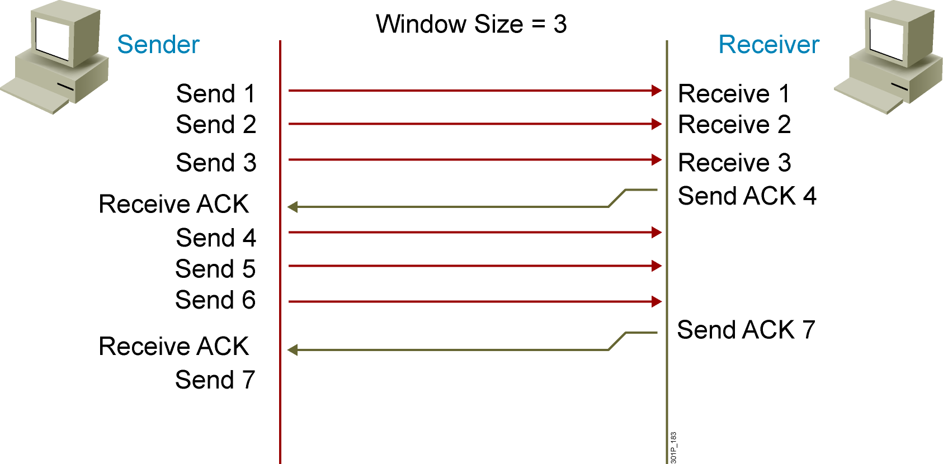
Fixed Windowing
Notes:
Lesson Aim
<Enter lesson aim here.>

Slide 22
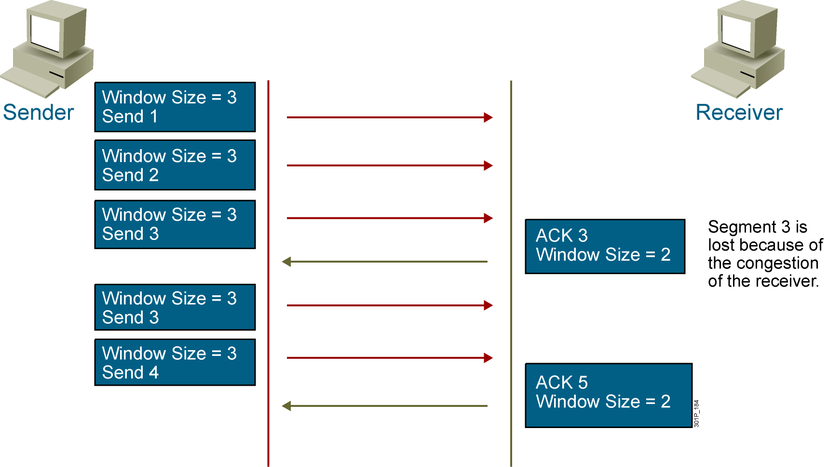
TCP Sliding Windowing
Notes:
Lesson Aim
<Enter lesson aim here.>

Slide 23
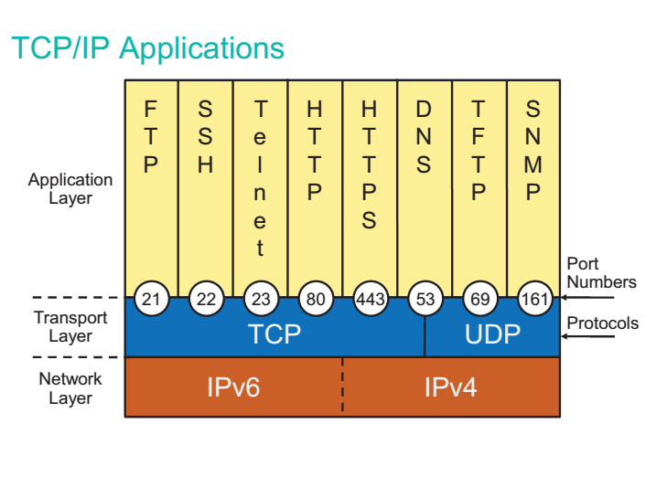

Slide 24
Network Infrastructure technologies

Slide 25
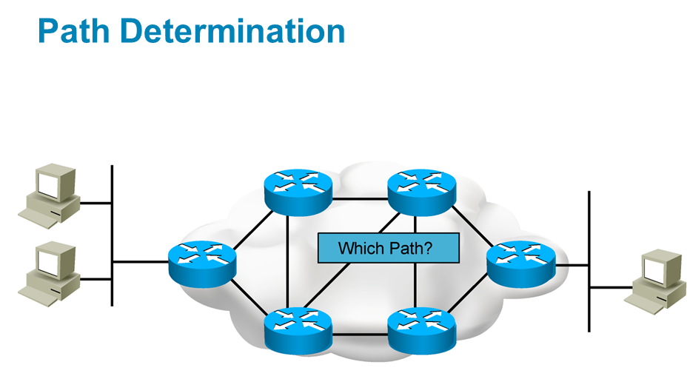
Routing technologies

Slide 26
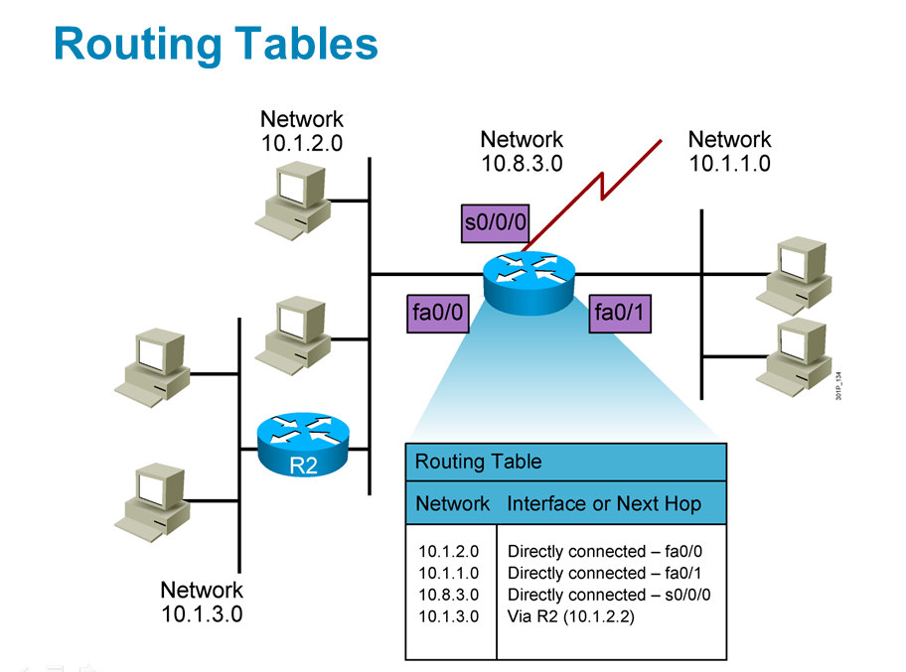

Slide 27
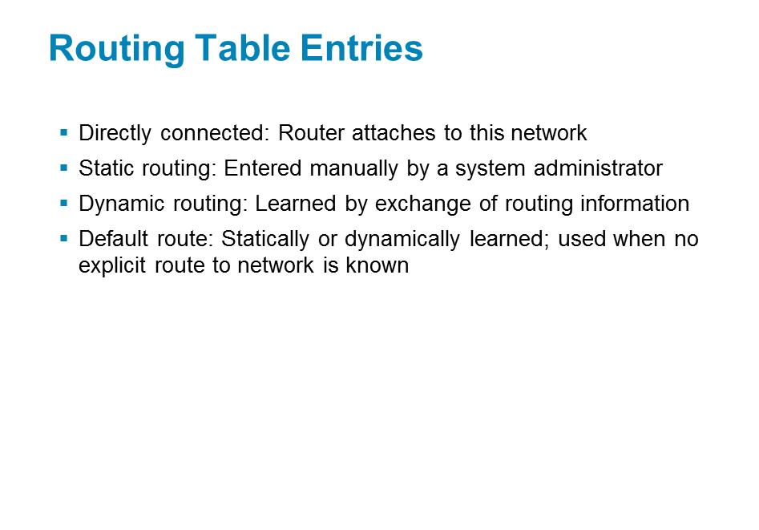

Slide 28
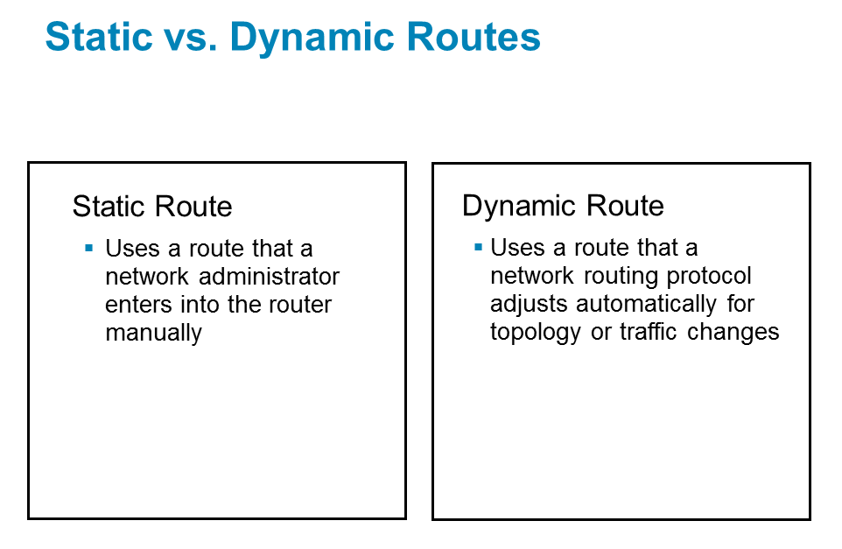

Slide 29
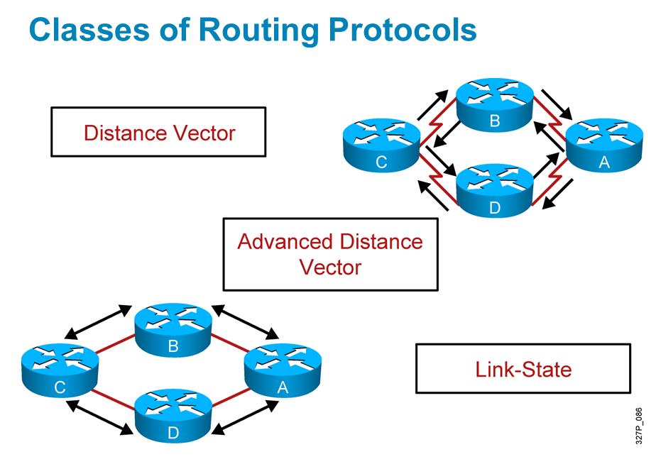

Slide 30
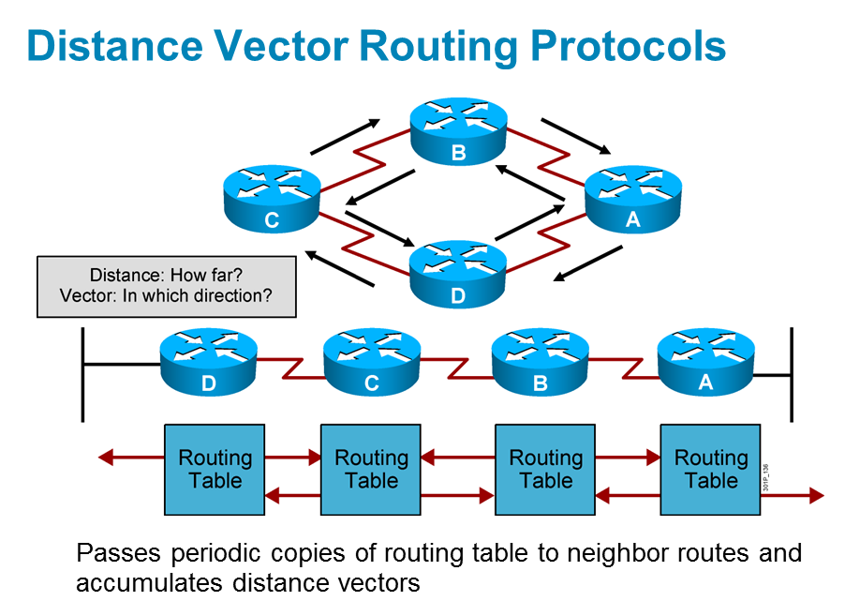

Slide 31
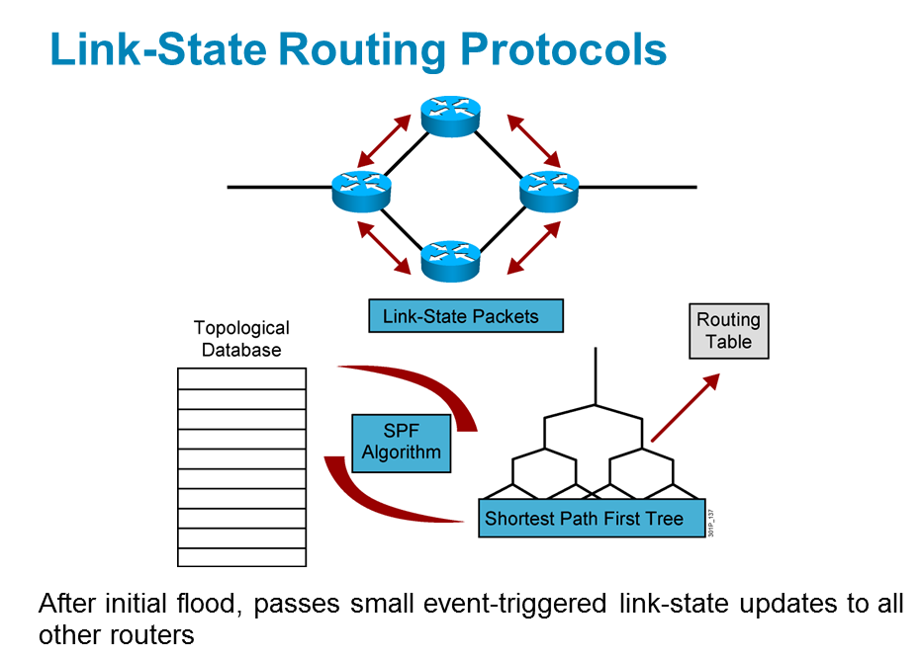

Slide 32
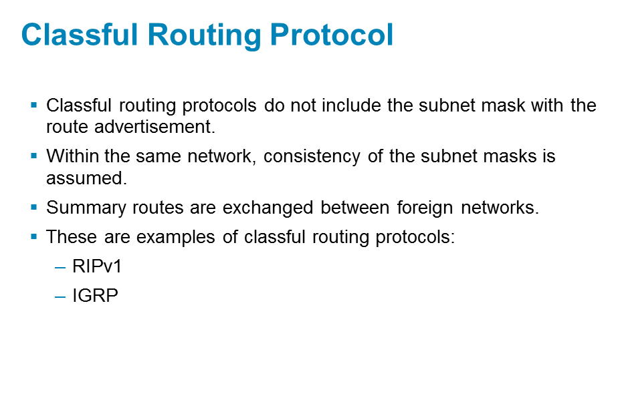

Slide 33
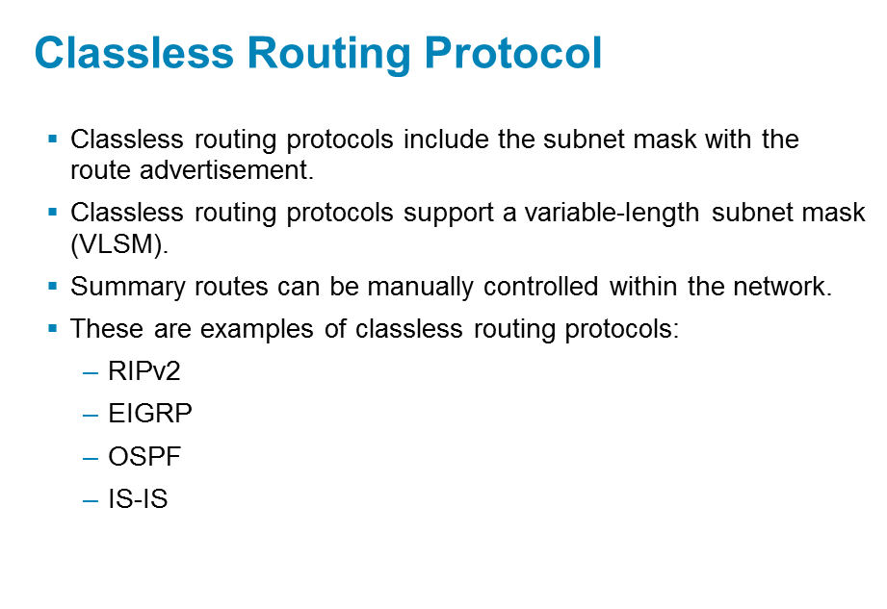

Slide 34
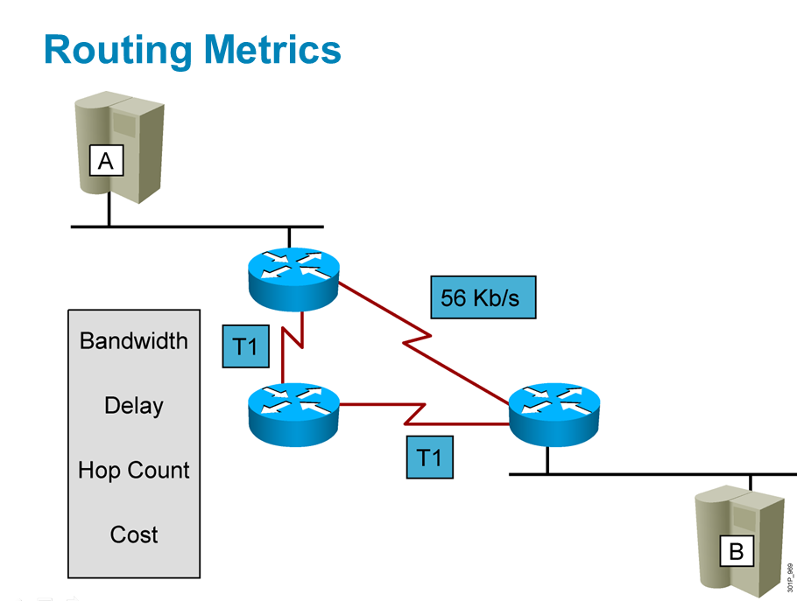

Slide 35
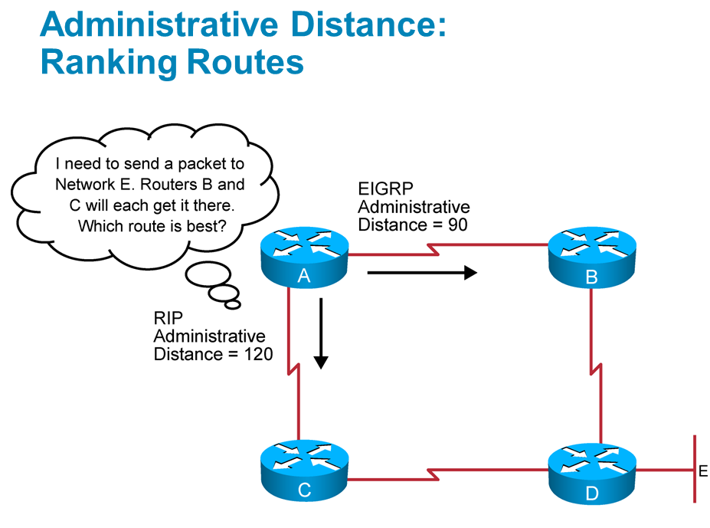

Slide 36
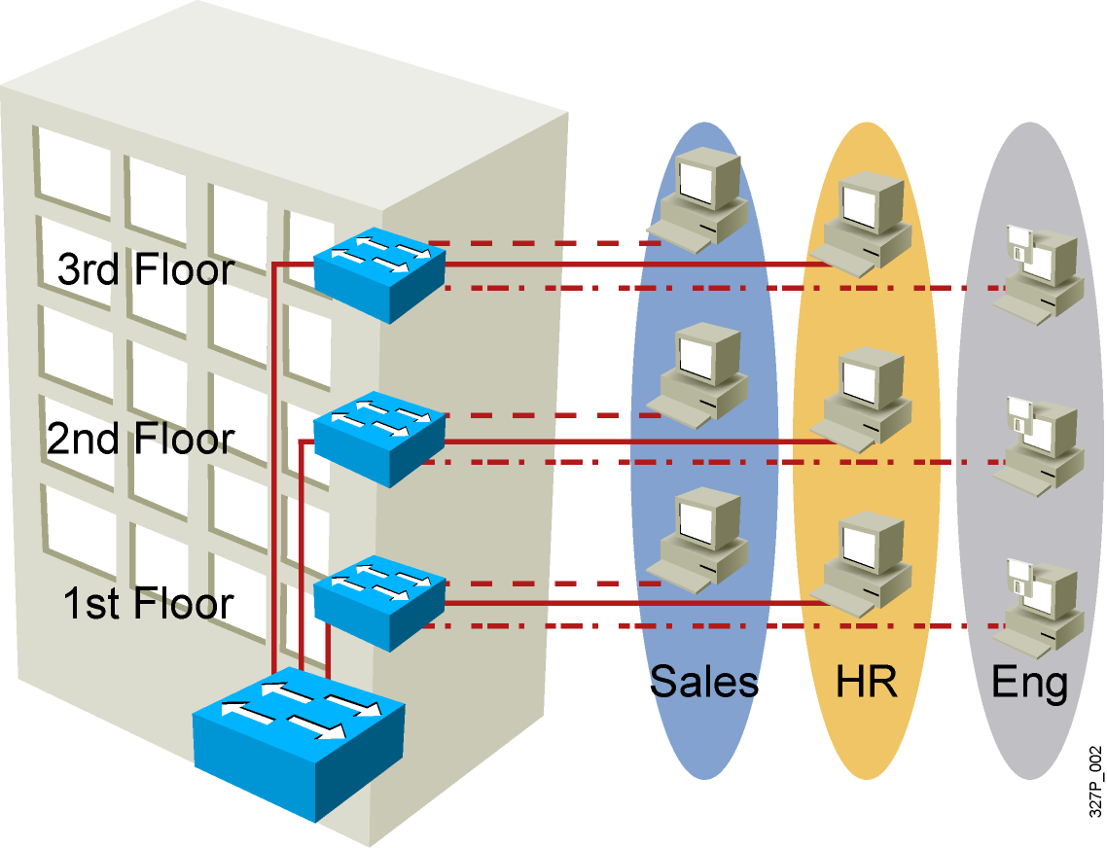
VLAN Overview
Segmentation
Flexibility
Security
VLAN = Broadcast Domain = Logical Network (Subnet)
Notes:
Purpose:
Emphasize: A VLAN is a broadcast domain.
Note: In order to have inter-VLAN communications, a router is required.

Slide 37
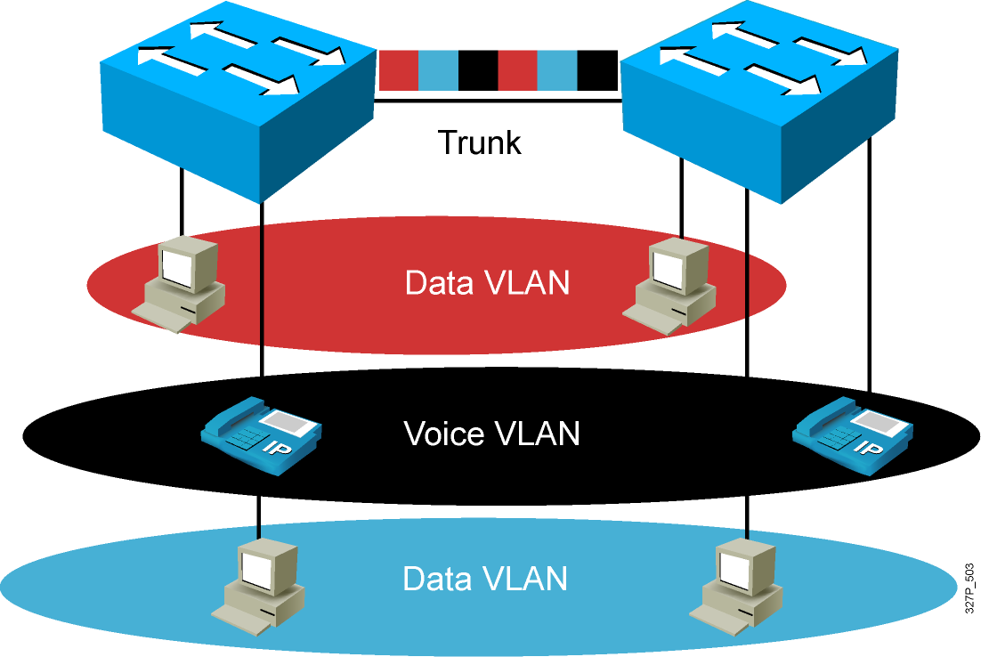
VLAN Operation

Slide 38
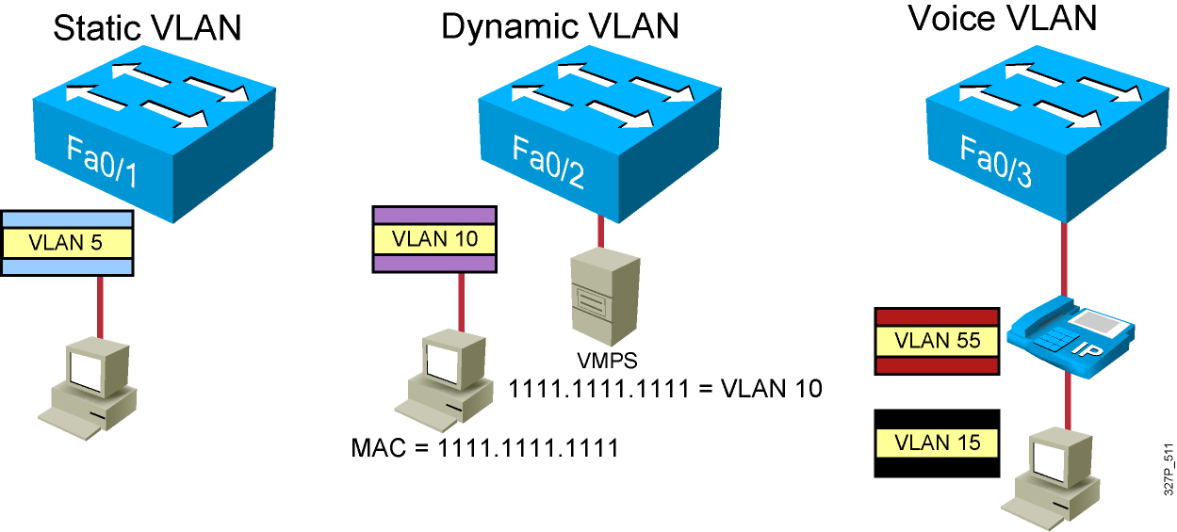
VLAN Membership Modes
Notes:
Note: Once a port has been assigned to a VLAN, it cannot send or receive traffic from devices in another VLAN without the intervention of a Layer 3 device like a router.
The 1900 can’t be configure as the VMPS.
A CiscoWorks 2000 or CWSI management station or a Catalyst 5000 switch can be configured as the VMPS.
In the future, dynamic VLANs may also offer membership based on other criteria such as protocol or application. Dynamic VLANs are covered in the Managing Cisco Switched Internetworks class.

Slide 39
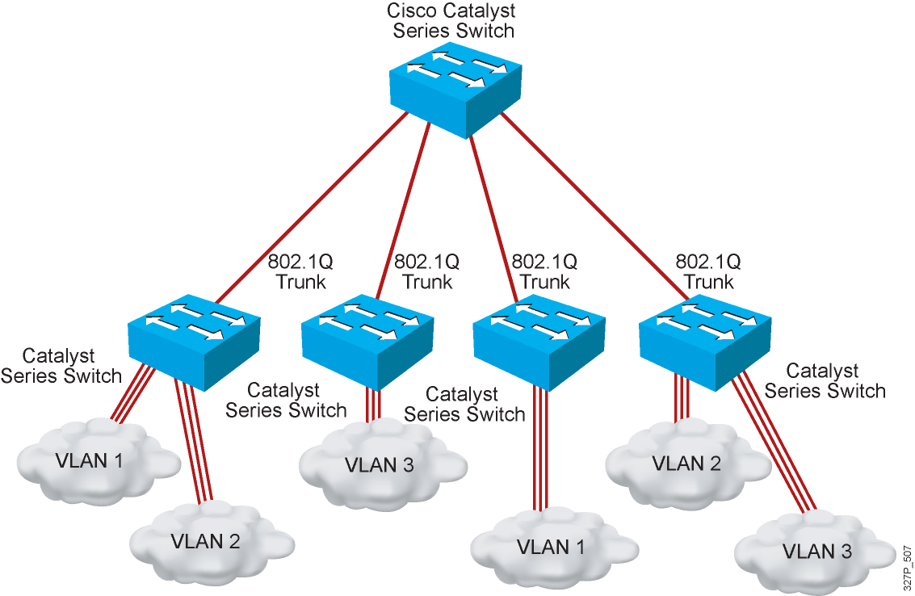
802.1Q Trunking

Slide 40
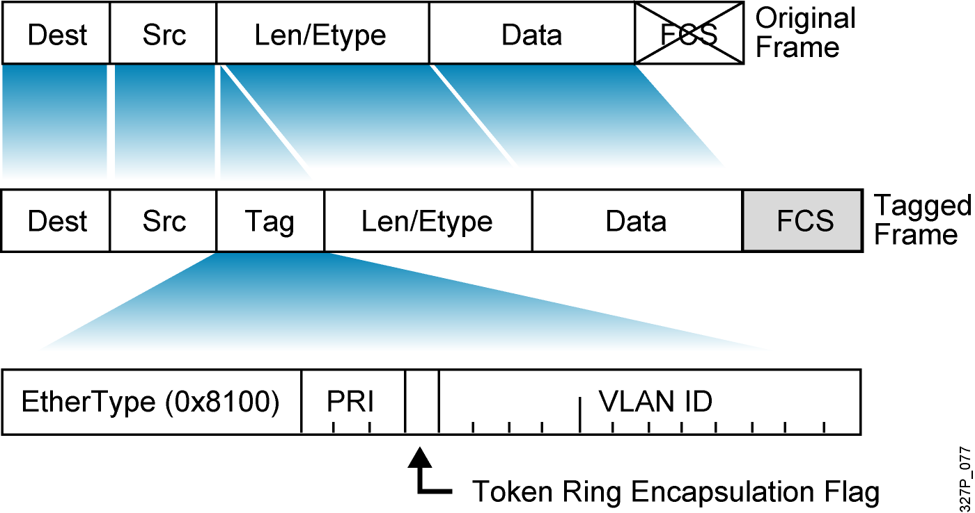
802.1Q Frame

Slide 41
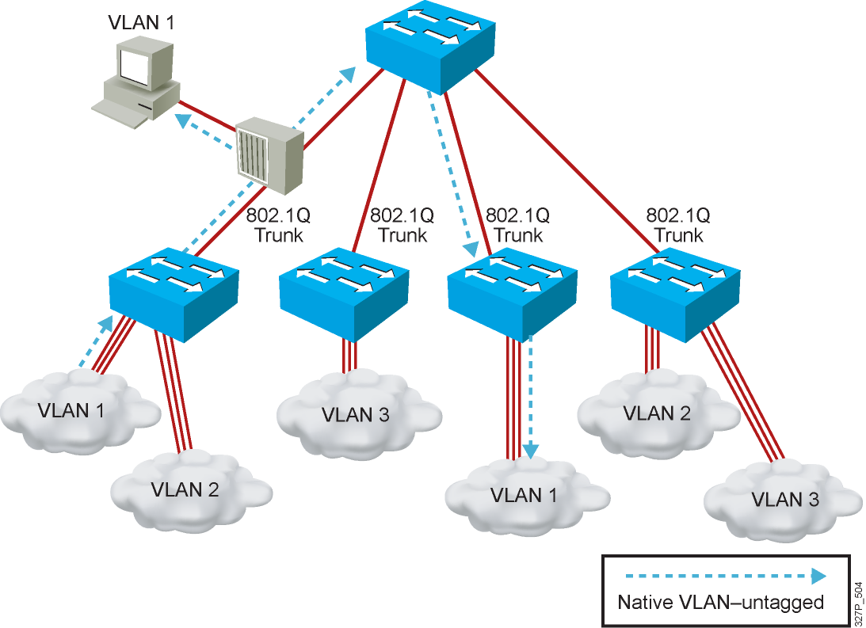
Understanding Native VLANs

Slide 42
Network Services

Slide 43
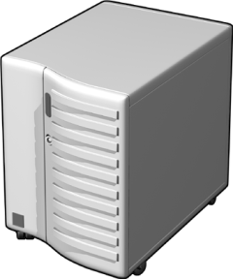


DHCP operation
DHCP operation
DHCP Server2
DHCP Server2
DHCP Server1
DHCP Server1
DHCP Client
DHCP Client
DHCP client broadcasts a DHCPDISCOVER packet
1
DHCP client broadcasts a DHCPDISCOVER packet
1
DHCP servers broadcast a DHCPOFFER packet
2
DHCP servers broadcast a DHCPOFFER packet
2
DHCP client broadcasts a DHCPREQUEST packet
3
DHCP client broadcasts a DHCPREQUEST packet
3
DHCP Server1 broadcasts a DHCPACK packet
4
DHCP Server1 broadcasts a DHCPACK packet
4

Slide 44

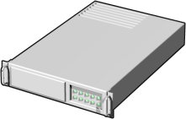

How a DHCP Relay Agent Works
DHCP Relay Agent
DHCP Server
DHCP Relay Agent
DHCP Server
Client2
Client2
Router
Non-RFC 1542 Compliant
Client1
Router
(Non–RFC 1542 Compliant)
Client3
Client3
Client1
1
Client1 broadcasts a DHCPDISCOVER packet
2
Relay agent forwards the DHCPDISCOVER message to the DHCP server
3
Server sends a DHCPOFFER message to the DHCP relay agent
4
Relay agent broadcasts the DHCPOFFER packet
5
Client1 broadcasts a DHCPREQUEST packet
6
Relay agent forwards the DHCPREQUEST message to the DHCP server
7
Server sends a DHCPACK message to the DHCP relay agent
8
Relay agent broadcasts the DHCPACK packet

Slide 45
DNS

Slide 46
WEB

Slide 47
FTP

Slide 48
E-Mail

